Slide 1

IOT Based Smart Street Lighting System

Slide 2

IOT Based Smart Street Lighting System
PRESENTED BY
NAME : SHAURYA GUPTA REG.NO : 18BLC1092
NAME : GAURI MADAAN REG.NO : 18BLC2097
Under the Guidance of,
Dr. Balamurugan MS.,
Associate Professor,
School of Electronics Engineering,
VIT Chennai,
Chennai- 600127.

Slide 3
Abstract
Smart led street lighting system proposes to design and execute the recent advanced development in IOT for energy savings of street lights. The best solution for the reduction of electrical power wastage is the automation of street light and for the manual operation of the lighting system to be completely eliminated. A method for modifying street light illumination is by using sensor at minimum electrical energy consumption, such as when an objects presence is detected, street lights will glow at their brightest, else they would stay in the dim mode during the night time. Internet of things (IOT) is used to visualize the real time updates of street processing and notifying the changes that occur and in what period of time. This would reduce power consumption, maintenance heat emissions, and replacement costs.

Slide 4
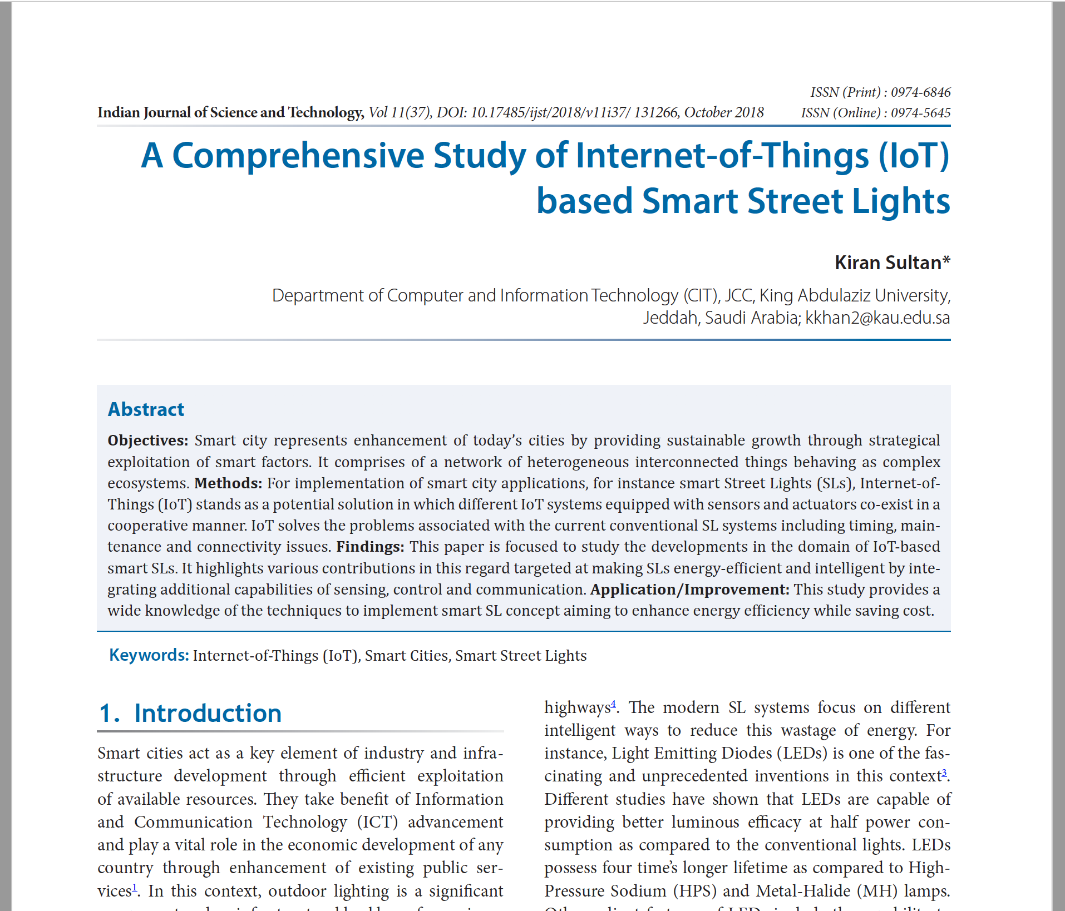
LITRATURE REVIEW
Kiran Sultan*Department of Computer and Information Technology (CIT ), JCC, King Abdulaziz University,
A Comprehensive Study of Internet-of-Things (IoT) based SmartStreet Lights (2018),
Link - https://indjst.org/articles/a-comprehensive-study-of-internet-of-things-iot-based-smart-street-lights

Slide 5
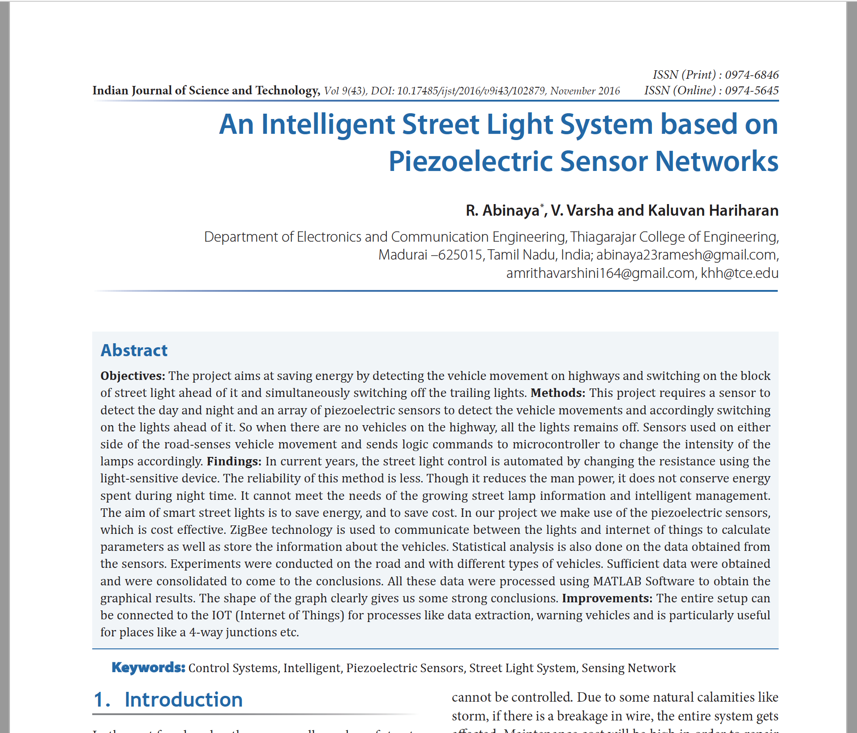
LITRATURE REVIEW
R. Abinaya*, V. Varsha and Kaluvan , Thiagarajar College of Engineering, Hariharan Department of Electronics and Communication Engineering, Thiagarajar College of Engineering,
An Intelligent Street Light System based on Piezoelectric Sensor Networks (2016)
Link - https://indjst.org/articles/an-intelligent-street-light-system-based-on-piezoelectric-sensor-networks

Slide 6
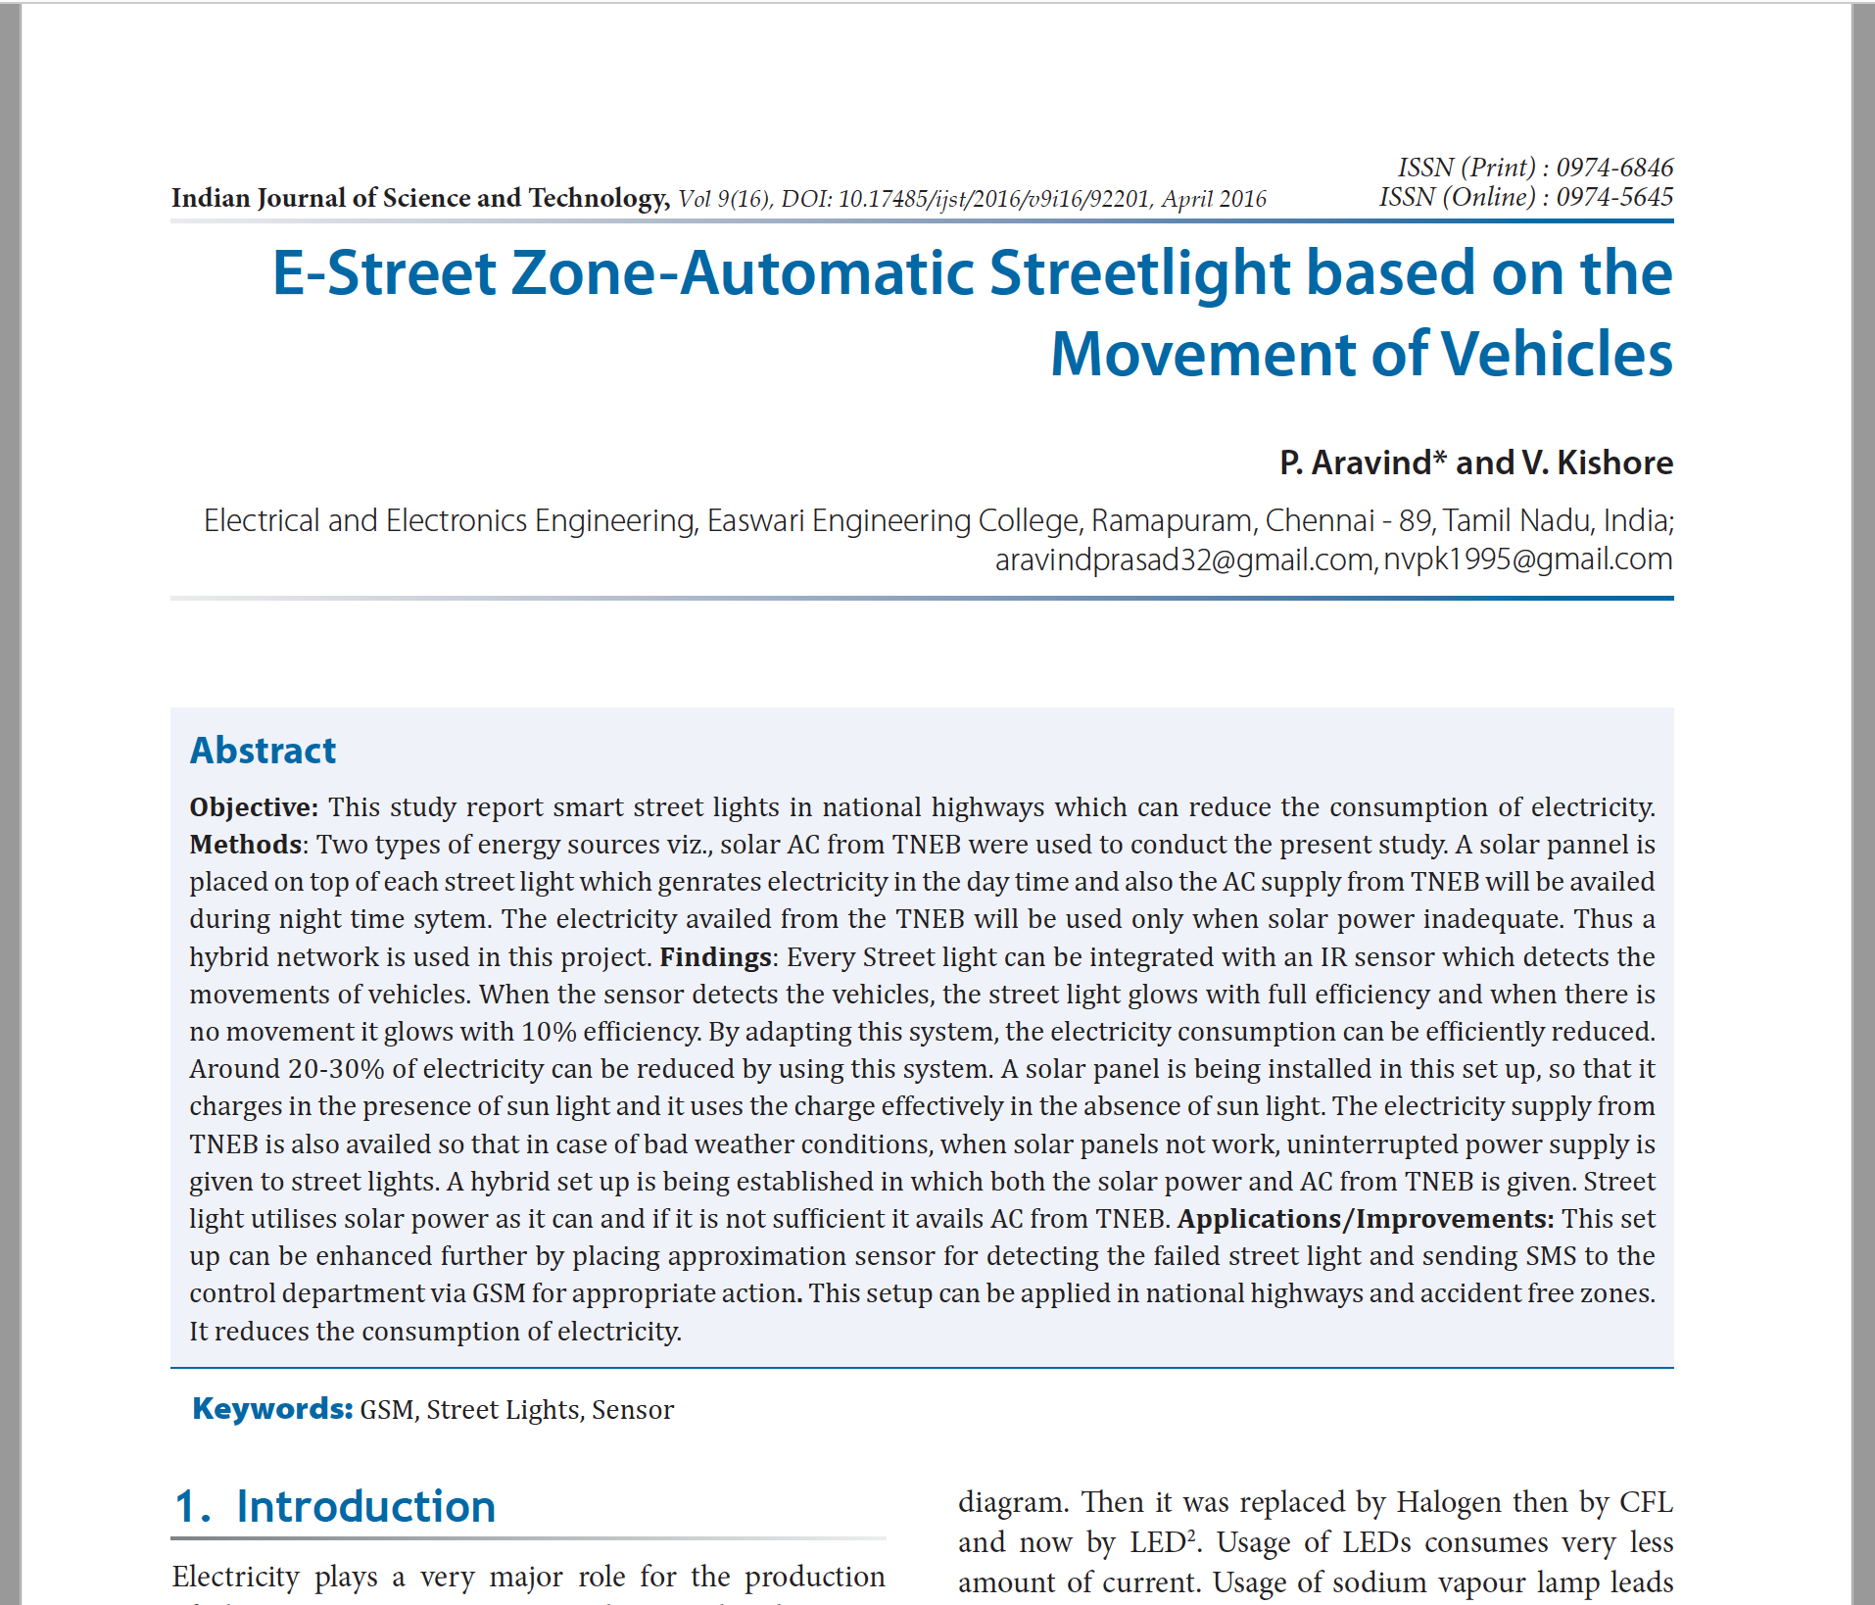
LITRATURE REVIEW
P. Aravind* and V. KishoreElectrical and Electronics Engineering, Easwari Engineering College, Ramapuram, Chennai,
E-Street Zone-Automatic Streetlight based on the Movement of Vehicles(2016),
Link - https://indjst.org/articles/e-street-zone-automatic-streetlight-based-on-the-movement-of-vehicles

Slide 7
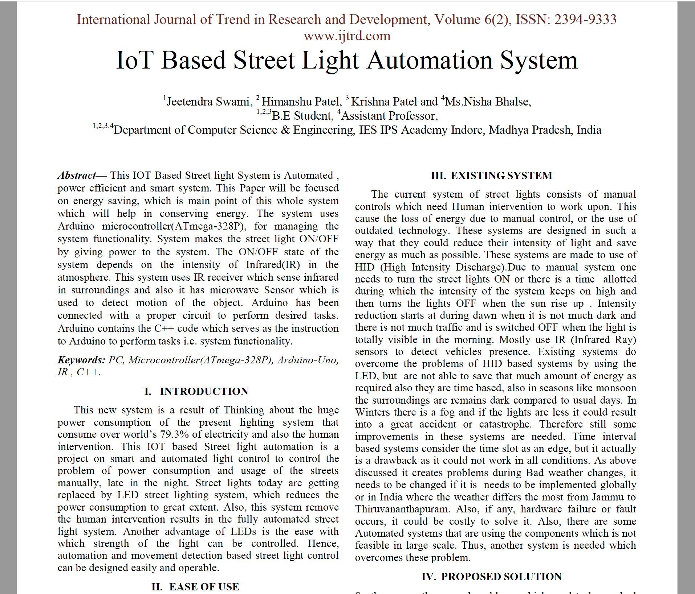
LITRATURE REVIEW
Jeetendra Swami, Himanshu Patel, Krishna Pateland, Ms.Nisha Bhalse,B.E Student,4Assistant Professor,Department of Computer Science & Engineering, IES IPSAcademy Indore,
IoT Based Street Light Automation System(2019),
Link - www.ijtrd.com/papers/IJTRD20377.pdf

Slide 8
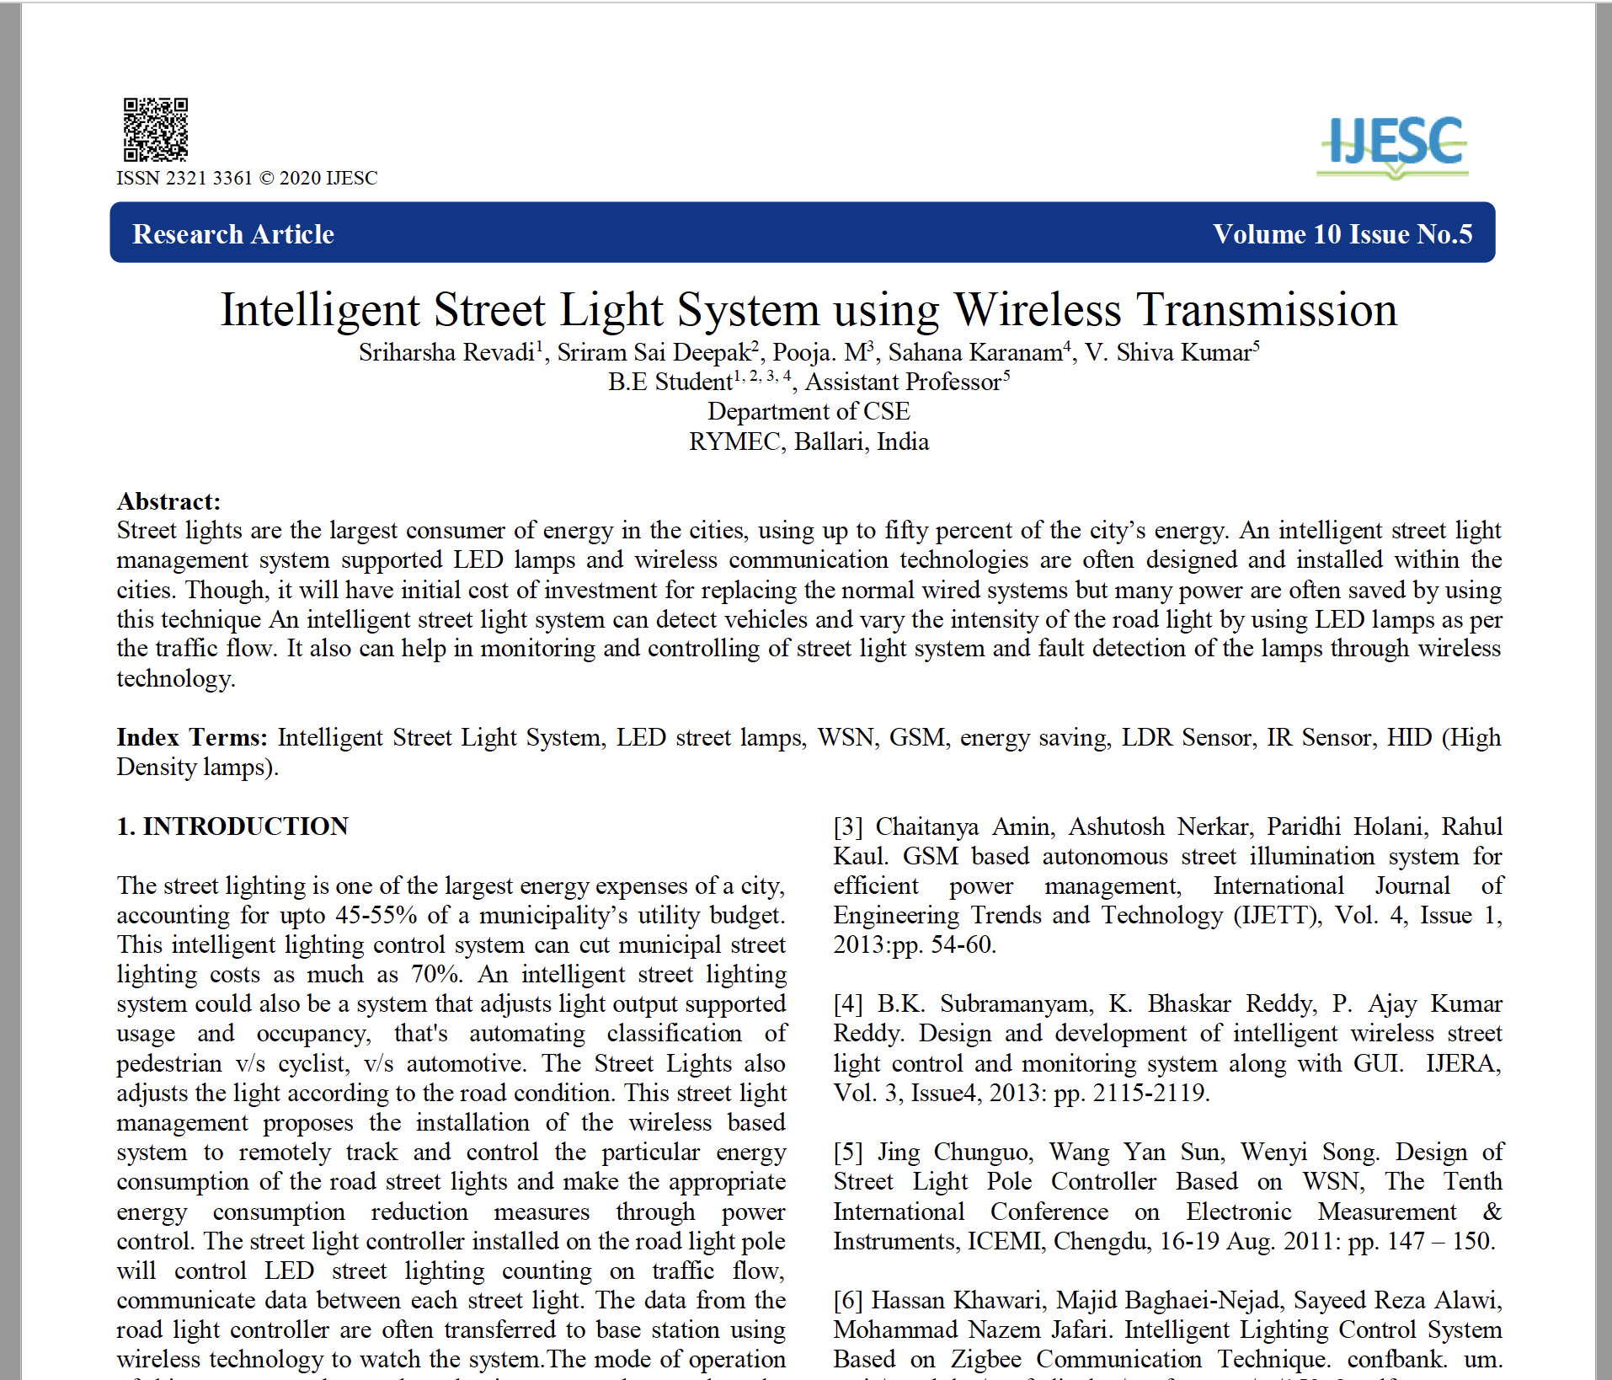
LITRATURE REVIEW
Sriharsha Revadi, Sriram Sai Deepak, Pooja. M, Sahana Karanam, V. Shiva Kumar, B.E Student, Assistant Professor,Department of CSE, RYMEC, Ballari, India
Intelligent Street Light System using Wireless Transmission (2020)
Link - https://ijesc.org/upload/18a30b18b554e1e2d52f81cfb8d797ac.Intelligent%20Street%20Light%20System%20using%20Wireless%20Transmission.pdf

Slide 9
PROBLEM statement
Streetlights are an integral part of any developing locality. They are present on all major road-ways and in the suburbs too. Every day, streetlights are powered from sunset to sunrise at full strength, even when there is no one around. On a global scale, millions of dollars are spent each day on these street lights to provide the required electrical energy. This paper gives the best solution for electrical power wastage.

Slide 10
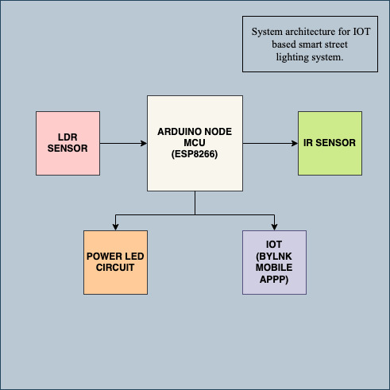
METHODOLOGY
BLOCK DIAGRAM – System Architecture of the system.

Slide 11
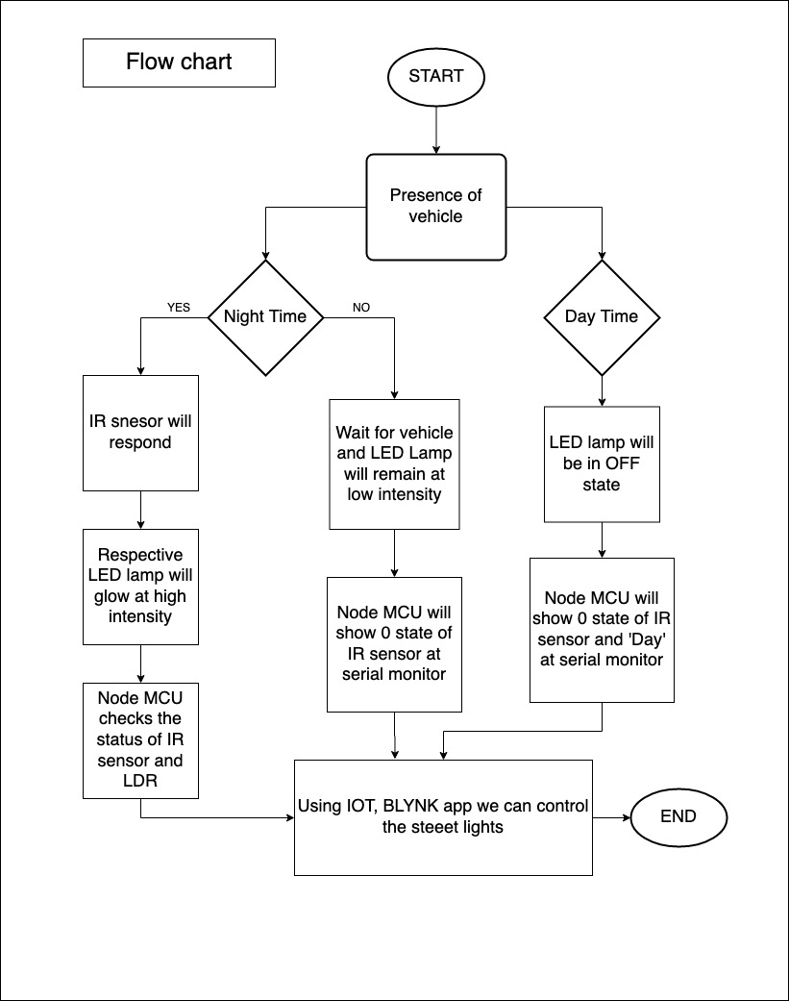
METHODOLOGY
FLOWCHART

Slide 12
COMPONENTS
S. no | HARDWARE COMPONENTS
1. | ARDUINO NODE MCU(ESP8266)
2. | IR Sensor (x3)
3. | LDR
4. | LED (x3)
5. | Breadboard
6. | Resistors and Jumper cables
SOFTWARE COMPONENT | BLYNK APPLICATION

Slide 13
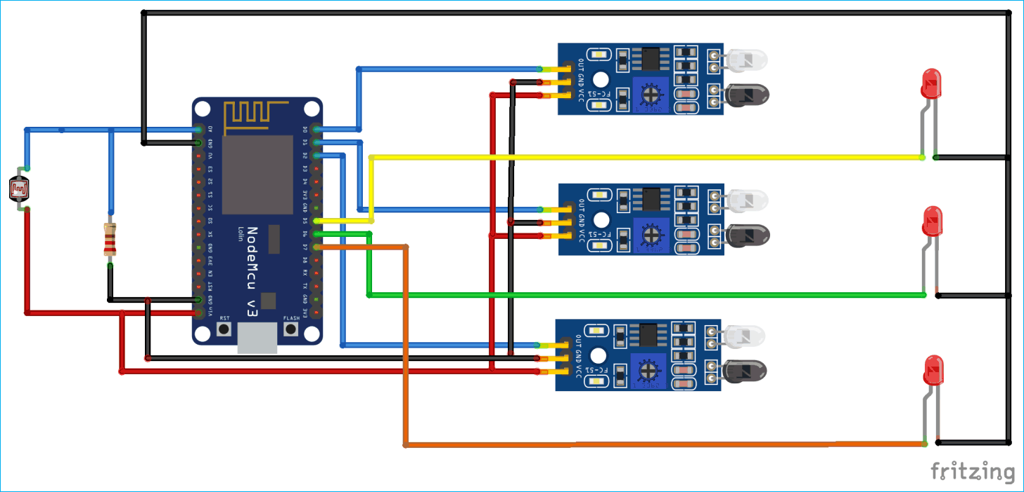
CIRCUIT DESIGN

Slide 14
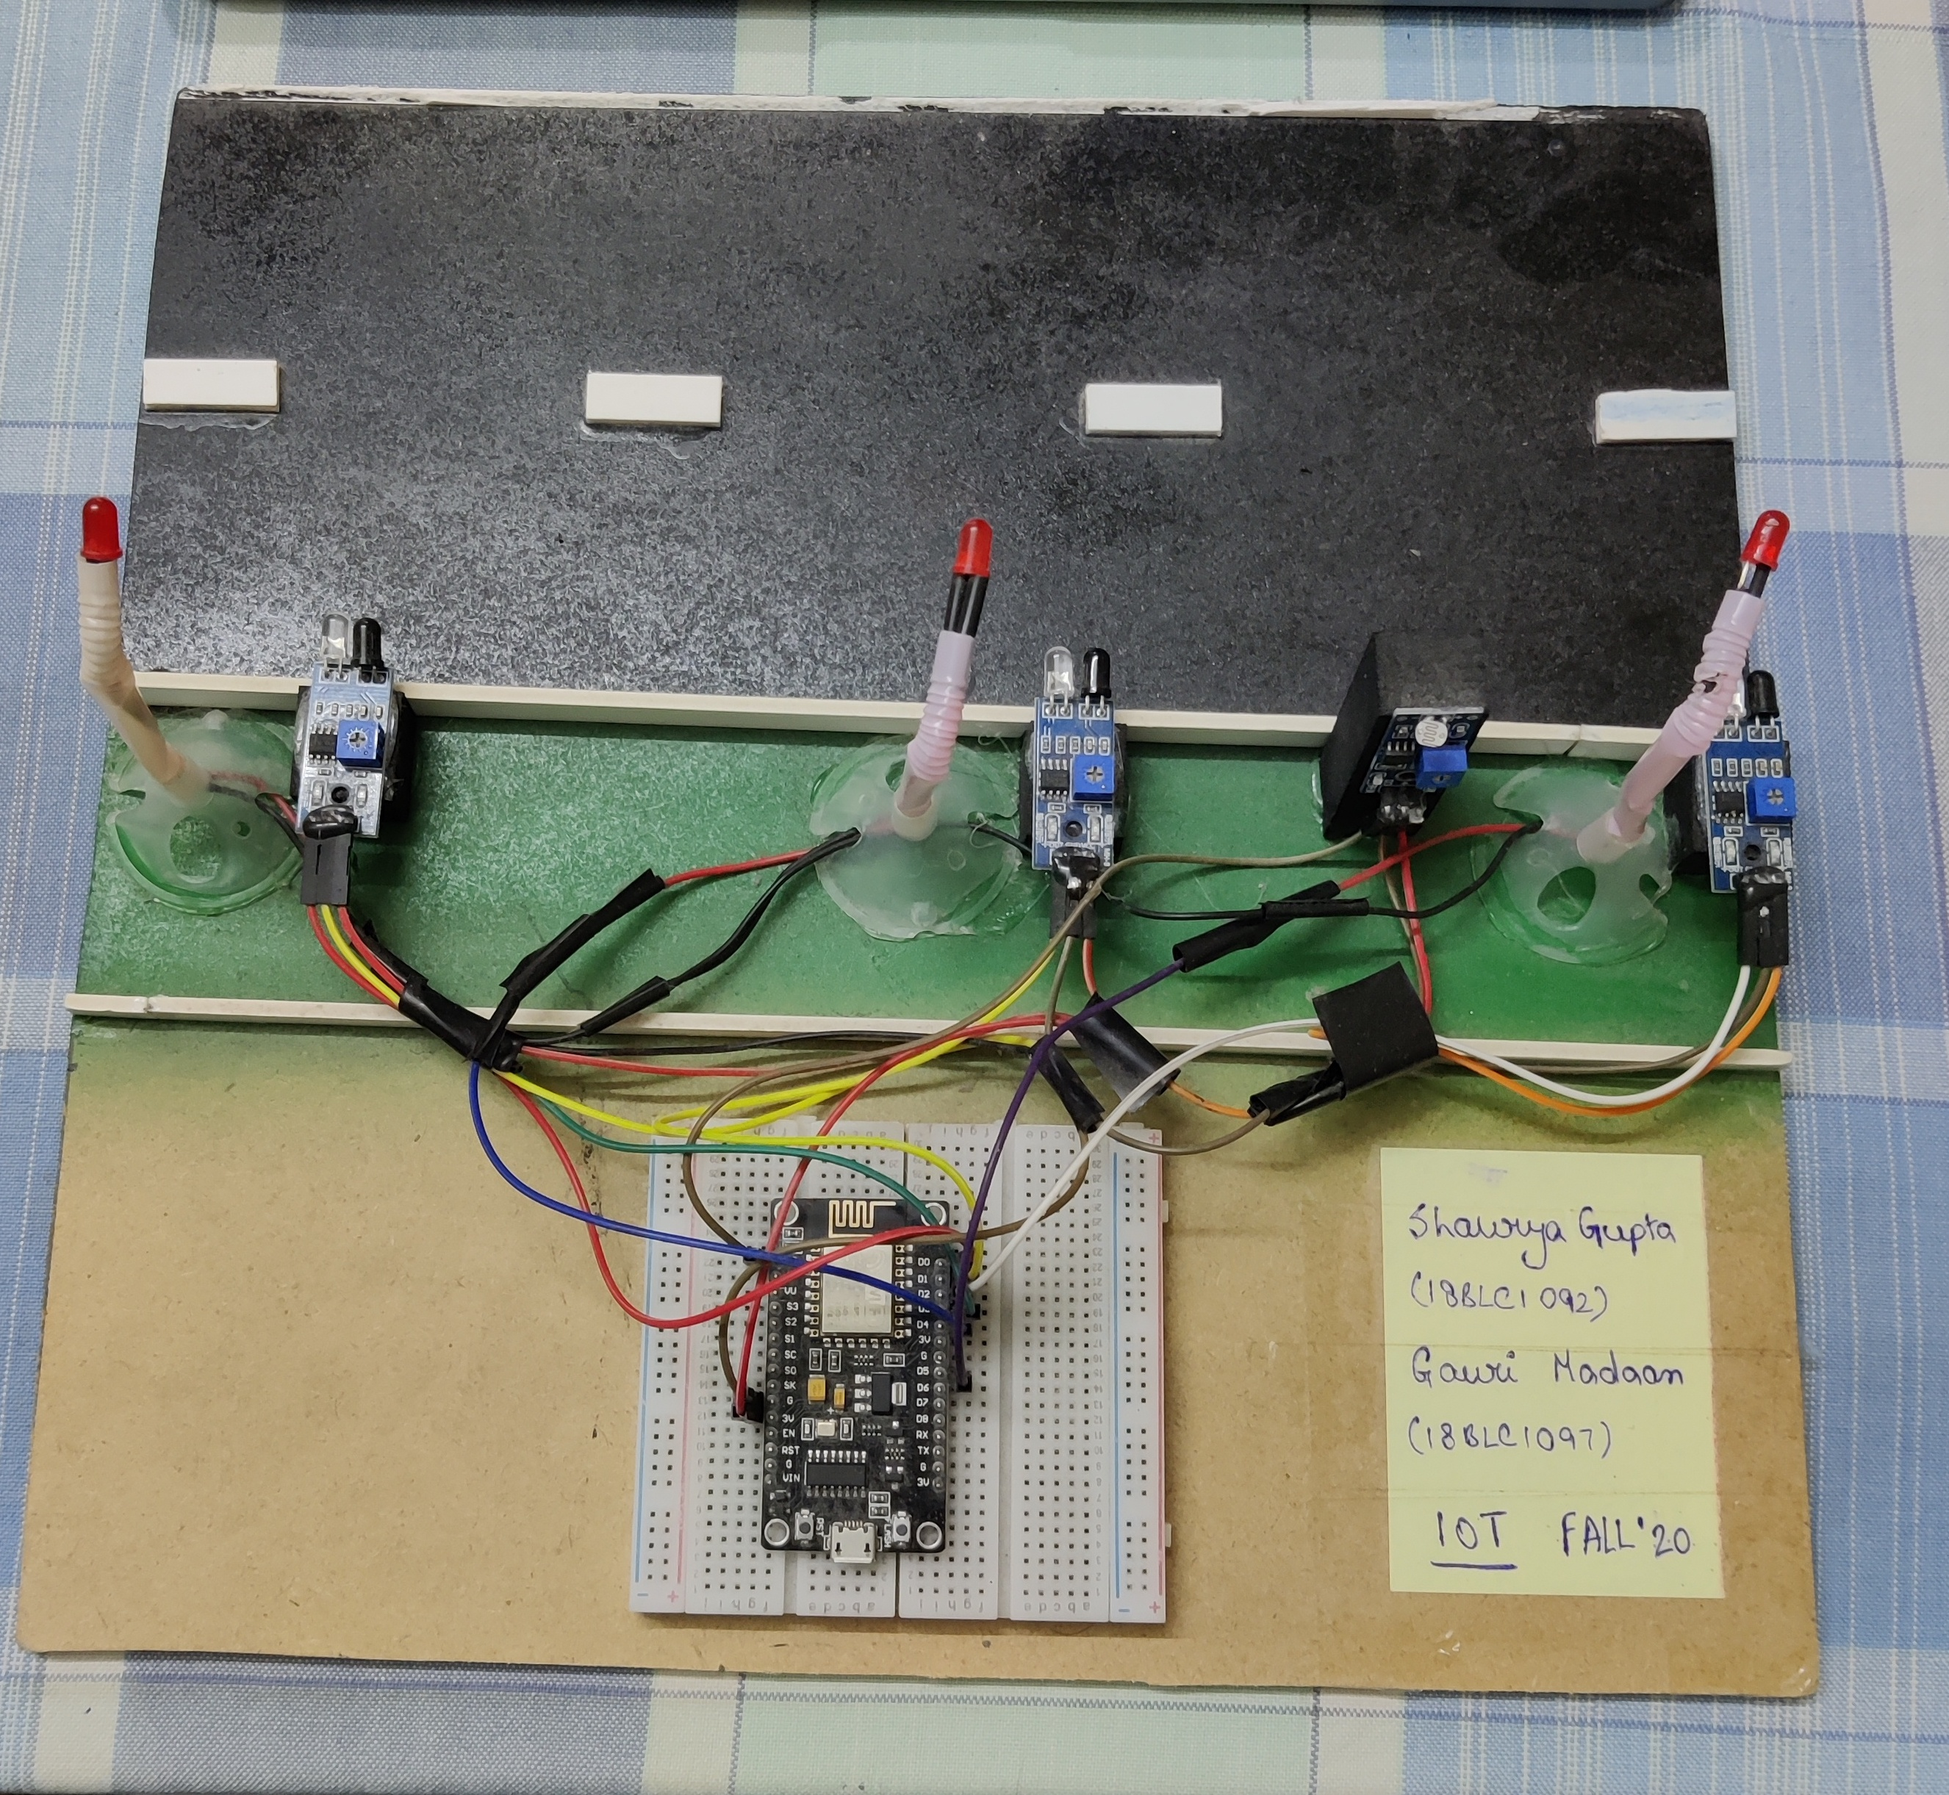
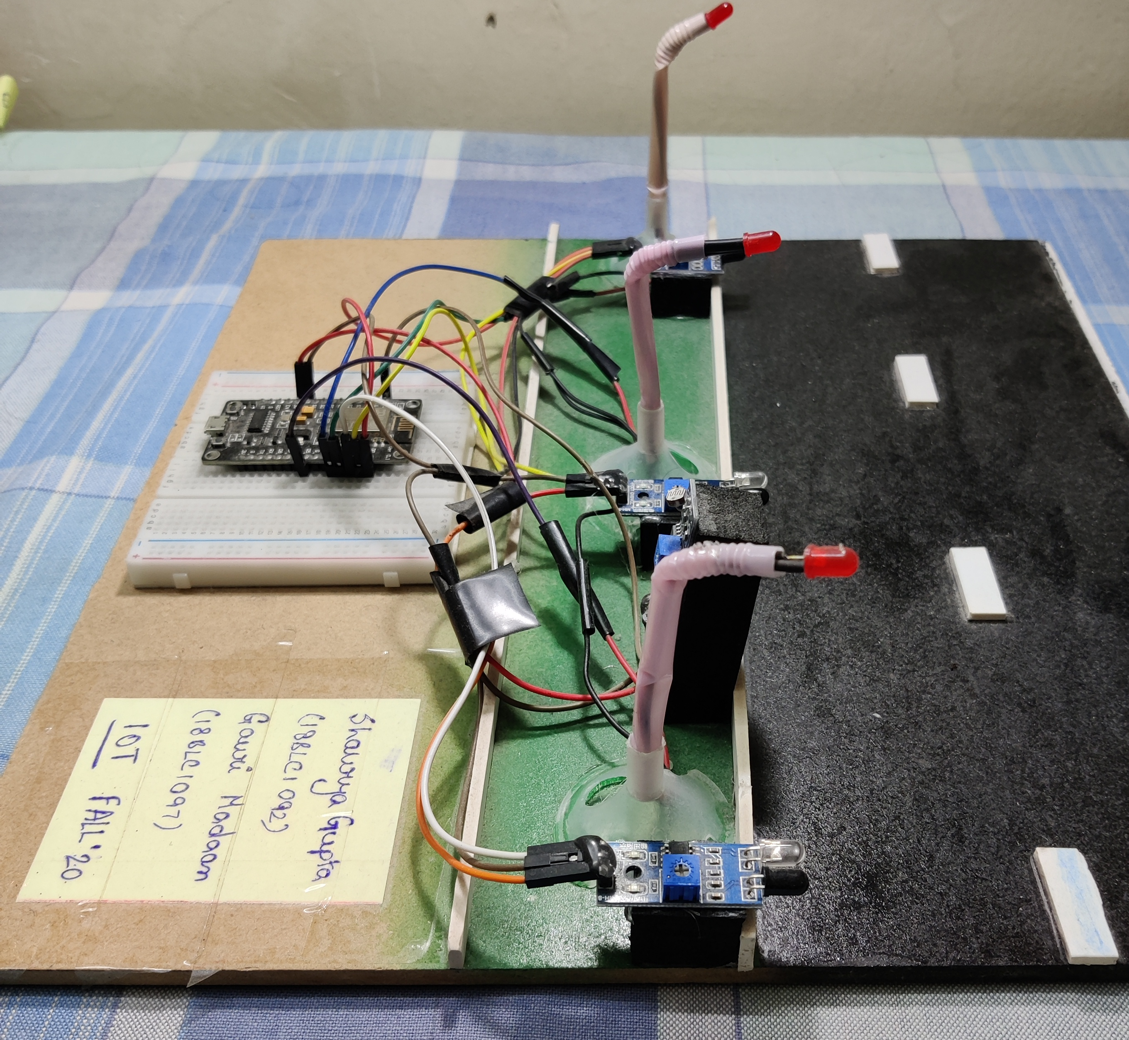
Implementation:

Slide 15
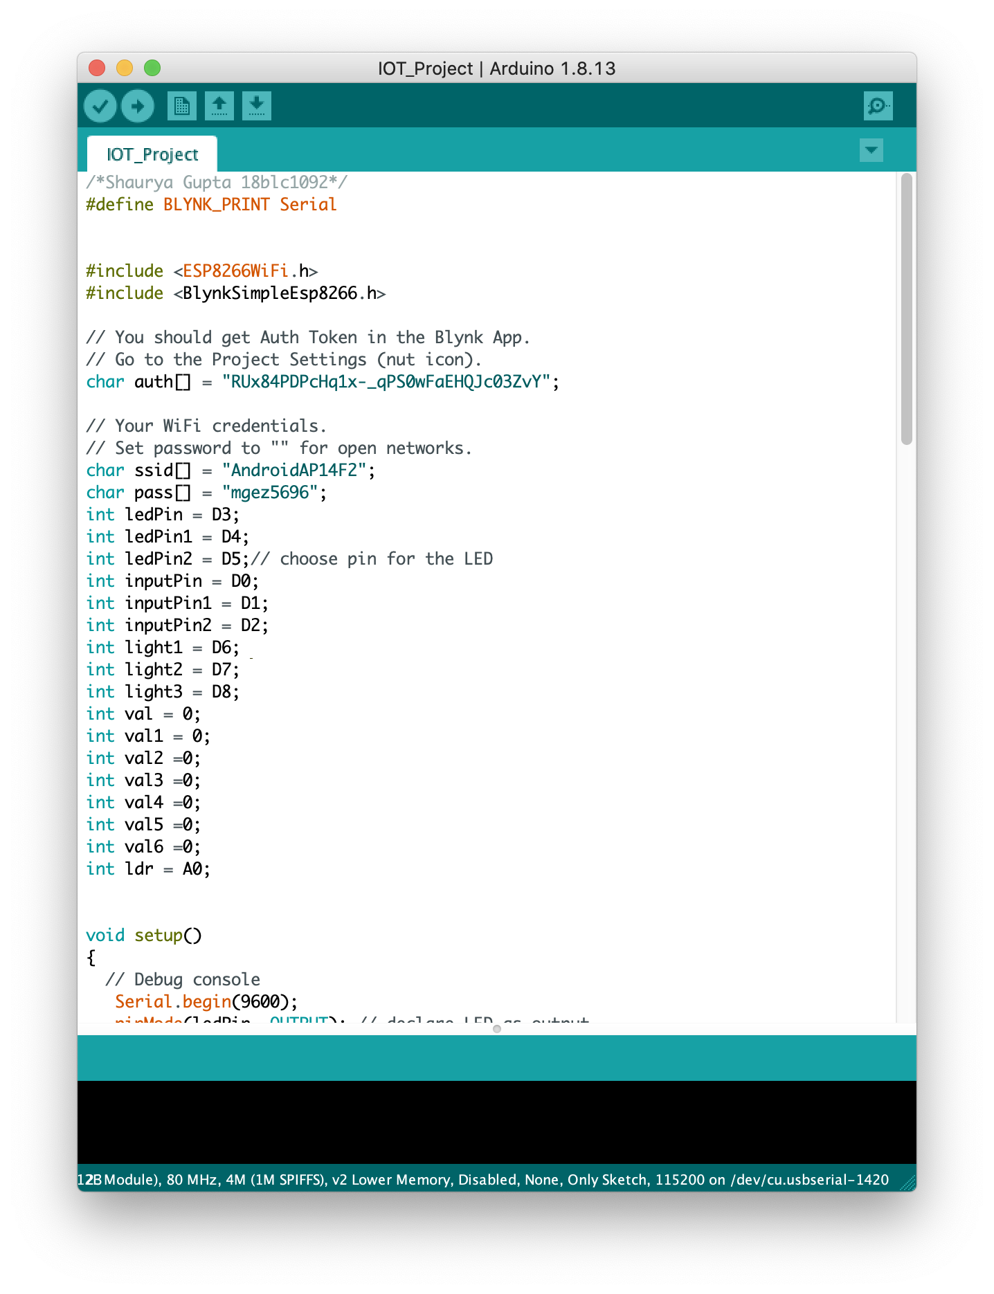
IMPLEMENTATION CODE:
All the components are to be connected with Arduino board. In this input module of the project, we used 3 IR sensors which are interfaced with Arduino Mode MCU(ESP8266) and work individually with respective to each other. In this we are connecting the output pins of IR sensor to pins D0,D1,D2 of Arduino Mode MCU(ESP8266) to give status of IR sensor. IR sensor senses the presence of a vehicle or a pedestrian on the road and switches the LED street lamps on the road through output module.
All IR sensor works on 5V and Arduino Mode MCU(ESP8266) is working on less than 5V supply (Battery or Laptop USB driver).two virtual switches are connected to Arduino Node MCU though BLYNK application.

Slide 16
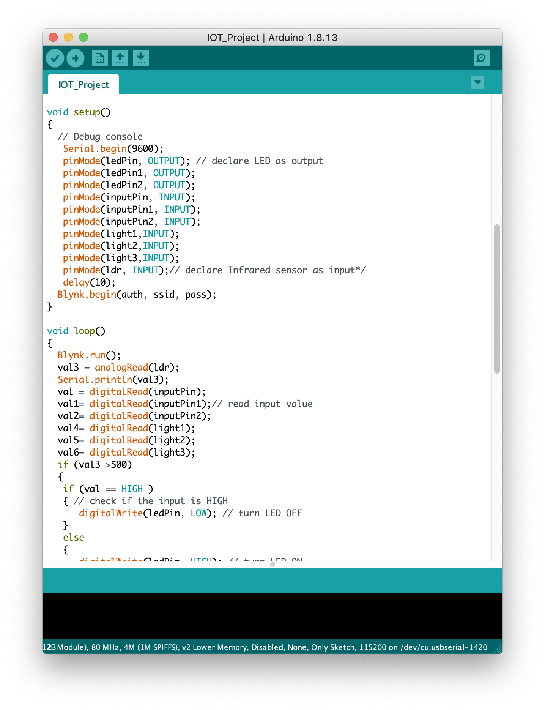


CONTINUED:

Slide 17
RESULT
The project aims were to reduce the side effects of the current lighting system and find a solution to save power. In this project the first thing to do is to prepare the inputs and outputs of the system to control the lights. The project shown in the figure has been implemented and works as expected and will prove to be very useful.

Slide 18
ADVANATAGES
Maintenance cost is much low compared to conventional street light.
Intensity of LED can be controlled effectively without changes in its light color.
Risk of accidents is very low.
It is environmental friendly, no harmful emissions.
Longer life compared to conventional street lights.
Power consumption is much lower.
Solar street light is independent of grid as a result of this operating cost is low.

Slide 19
LIMITATIONS
•Rechargeable batteries have to be replaced from time to time.
•Non-availability of sunlight during rainy and winter seasons is a problem.
•Dust accumulation on the surface of panel creates a problem.
•It is sensitive to ambient light and require careful shielding.
•Can be more complicated to align detector pairs.
•Photo resistors are only sensitive to light and no other force can power it without risking damage.
•Also, they are unable to detect low light levels and may take a few seconds to deliver a charge while their electrons build up momentum.

Slide 20
CONCLUSION
The use of power electronics is increasing exponentially across various sectors of human life. The components used in the project, like Arduino Mode mcu and sensors are slowly becoming an indispensable part of our daily routines. So, it is only fitting that we use them to improve efficiency in every walk of life. Keeping in mind the urgent need for energy conservation, IoT based smart street lighting system is an excellent and effective solution. It combines safe lighting protocols with consumption of minimal amount of power. The energy savings, as discussed before are phenomenal. The future scope of this project expands into speed detection and customizable area of illumination.
An additional component which would lead to better functioning of the concept would be the use of LED bulbs. Despite their high initial costs, they are a viable option as they drastically reduce the power consumption. They will aid in further saving of energy and reduction in operational costs.

